Slide 1
NUTZ AND BOLTZ
TEAM
NUMBER
7

Slide 2
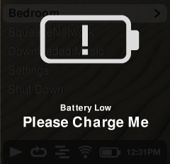
BUSY LIFE , TECHY PEOPLE,
GADGETS ALL AROUND
WHAT DO WE HATE THE MOST????
LOW BATTERY.......!!!!
SO WHAT TO DO.......

Slide 3
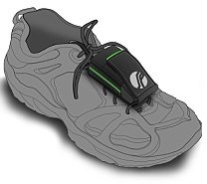
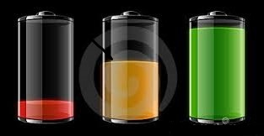
YOU JUST WALK , I WILL CHARGE YOUR BATTERY
WALK
WALK
WALK
AND WILL LIGHT YOUR WAY

Slide 4
MECHANISM
E-SHOES WILL BE PROVIDED WITH A PEIZO AND A BATTERY WITH USB .
WHEN A PERSON WILL WALK WITH THIS SHOE, THE PEIZO PROVIDED INSIDE WILL CONVERT THIS MECHANICAL ENERGY INTO ELECTRICAL ENERGY AND THIS ELECTRICAL ENERGY IS STORED IN THE FORM OF CHEMICAL ENERGY INTO THE BATTERY.
WHEN THE BATTERY IS PLUGGED INTO A GADGET. IT CHARGES THE GADGET .

Slide 5
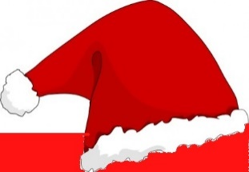
SIX THINKING HATS
ADDED ADVANTAGE OF TORCH
CHARGING ON THE MOVE
NO ELECTRICITY REQUIRED
NO MORE SEARCH FOR CHARGING SOCKETS
SMART LOOKING
REASONABLE PRICE
FEELING OF RELIEF
FEELING OF PRIDE
FEELING OF COMFORT

Slide 6
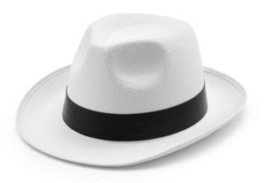
SIX THINKING HATS
HEAVY SHOES
MAINTAINANCE
COSTLIER THAN COMMON SHOES
PROCESS MAY BE COMPLICATED FOR SOME PEOPLE
BATTERY CAPACITY:5000mAH
OUTPUT: 2.1A/1A
4 LED TORCH
CHARGING DISTANCE:2.78kms

Slide 7
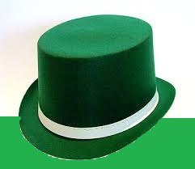
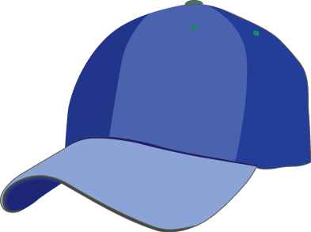
SIX THINKING HATS
IN-BUILT TORCH THAT GUIDES YOU THROUGH DARKNESS.
PEIZO CRYTALS EMBEDDED INTO SOLES FOR BETTER COMFORT.
IT IS A PORTABLE RECHARGEABLE BATTERY SHOE.
CHARGED BY WALKING.
ATTACHED TORCH.

Slide 8
MARKETING STRATEGY:
IDEA - A PRODUCT USED FOR MULTIPLE PURPOSES FOR WALKING,CHARGING, LIGHTING.
MARKET – FOR PEOPLE WHO ARE IN A TROUBLE OF HAVING A LOW CHARGE ON OUT DOORS.
IMPACT - IT WILL MAKE PEOPLE MORE ACCESSIBLE TO THEIR GADGETS TO WORK ON.

Slide 9
FINANCIAL HELP:
LIKE A WELL ESTABLISHED SHOE COMPANY.
WE NEED A FINE COLLOBORATION OF ALL COMPANIES.
WE ALSO NEED LEDs.

Slide 10
Welcome to the era where charging will make you slimmer.
Any Questions???

